Slide 1


Urban Transport System in Harare: Challenges and Policy Recommendations “Towards inclusive Socio Economic Transformation: Leaving No-one and No place behind”
Presented on Behalf of Prof. Eng. Q. C Kanhukamwe : Vice Chancellor - HIT
Harare Provincial Development Dialogue
Prof. J. Gwamuri
Pro-Vice Chancellor: Research Innovation and Commercialization
Email:jgwamuri@hit.ac.zw

Slide 2


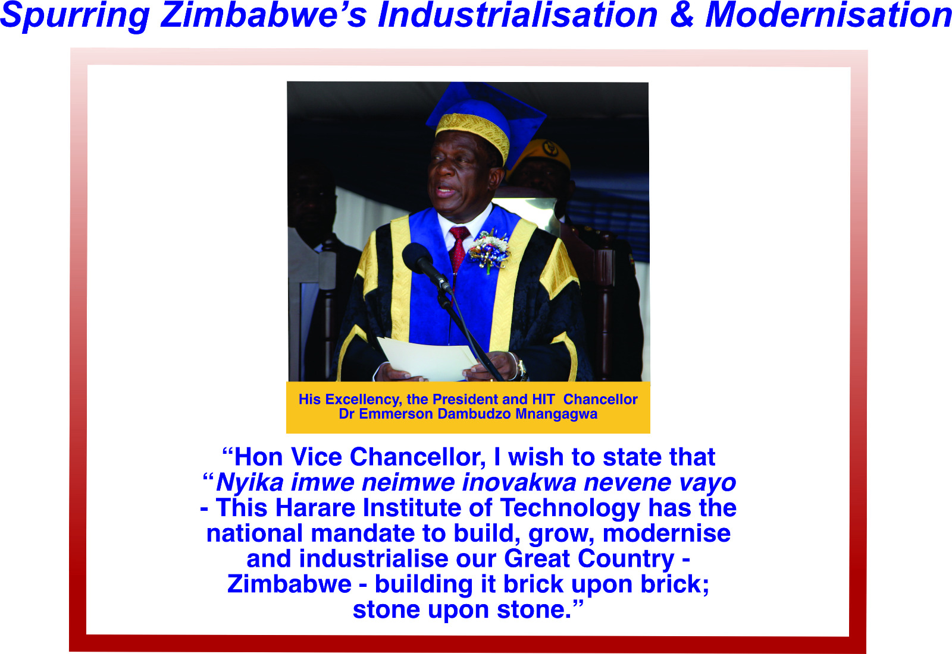
FOUNDATION OF HIT PRACTICE

Slide 3
HIT MANDATE
This is encapsulated in the HIT Act of 2005 Chapter [25:26] which outlines among other activities, that the university exists broadly to:
“Develop, incubate, transfer and commercialise technology for the rapid industrialisation of the country” DITC
DITC Philosophy informs our processes

Slide 4


Slide 5
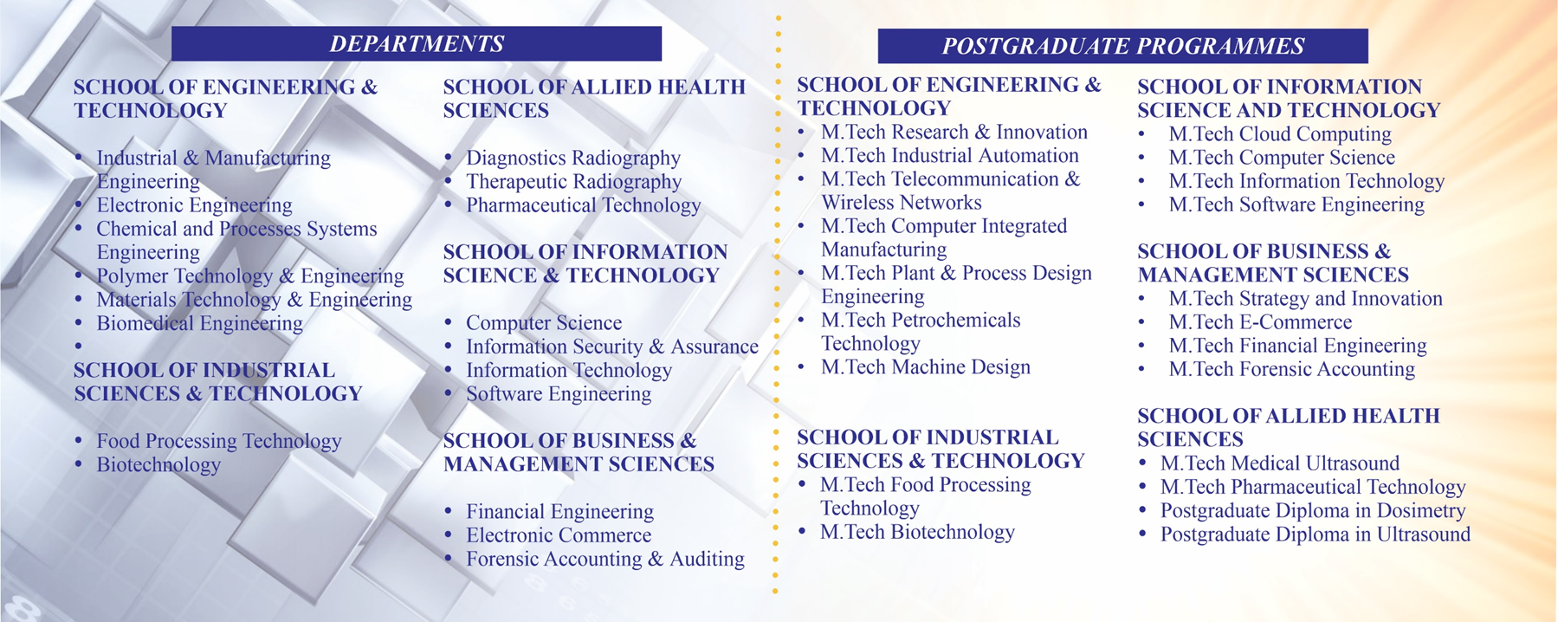
SCHOOLS

Slide 6

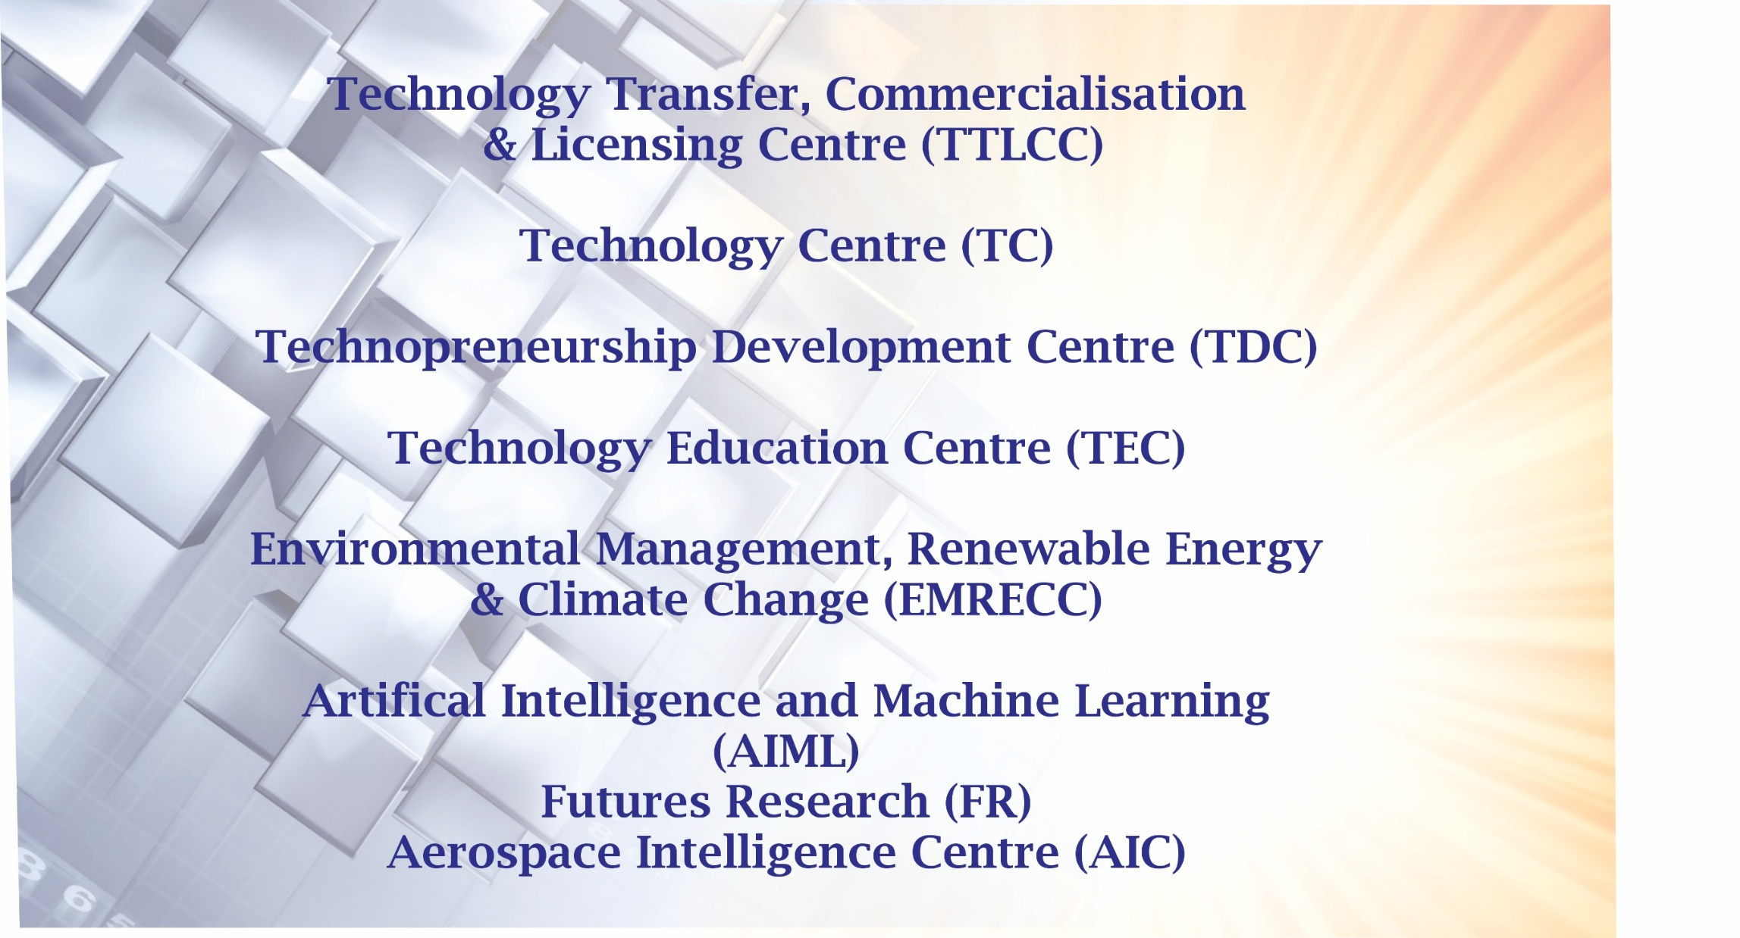
HIT CENTRES OF EXCELLENCE

Slide 7
Introduction: Harare Urban Transport System
Harare’s urban transport system is under immense pressure due to rapid urbanization, population growth, and outdated infrastructure.
HIT, through its mandate to develop, incubate, transfer, and commercialize technology, is actively contributing to sustainable urban mobility solutions.
This presentation outlines key challenges, policy recommendations, and HIT’s innovation-driven response.

Slide 8
Current Challenges in Harare’s Urban Transport
Congestion & Inefficiency: Over-reliance on informal transport (kombis), poor traffic flow, and lack of mass transit options.
Aging Infrastructure: Roads, signals, and public transport systems are outdated and poorly maintained.
Environmental Impact: High emissions from old vehicles contribute to air and noise pollution.
Policy Gaps: Fragmented regulatory frameworks and limited enforcement capacity.
Limited Accessibility: Inadequate infrastructure for persons with disabilities and non-motorized transport.

Slide 9
HIT’s Vision for Sustainable Transport
Light Rail Vehicle (LRV) Project: Design, manufacture, and deploy battery-powered trams for mass transit.
Urban Mobility Innovation Hub: A national centre for research, prototyping, and commercialization of transport technologies.
Smart Ticketing & Security Systems: Locally developed digital platforms for fare collection and commuter safety.
Hi-Tech Development Valley (HDV): Infrastructure to support transport R&D, manufacturing, and skills development.
Green Transport Advocacy: Promoting sustainability through clean energy and circular economy principles.

Slide 10
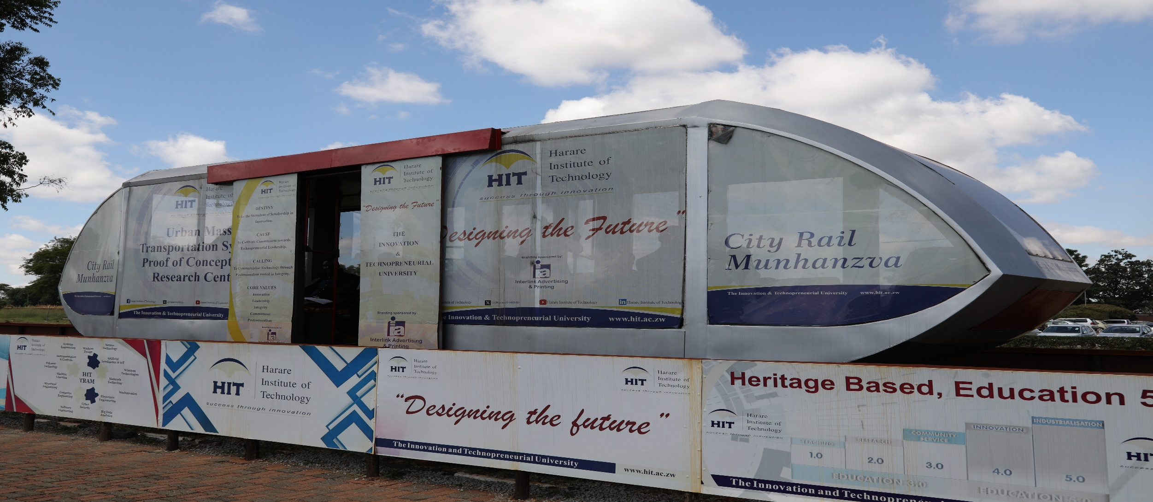
HIT’s Vision for Sustainable Transport

Slide 11
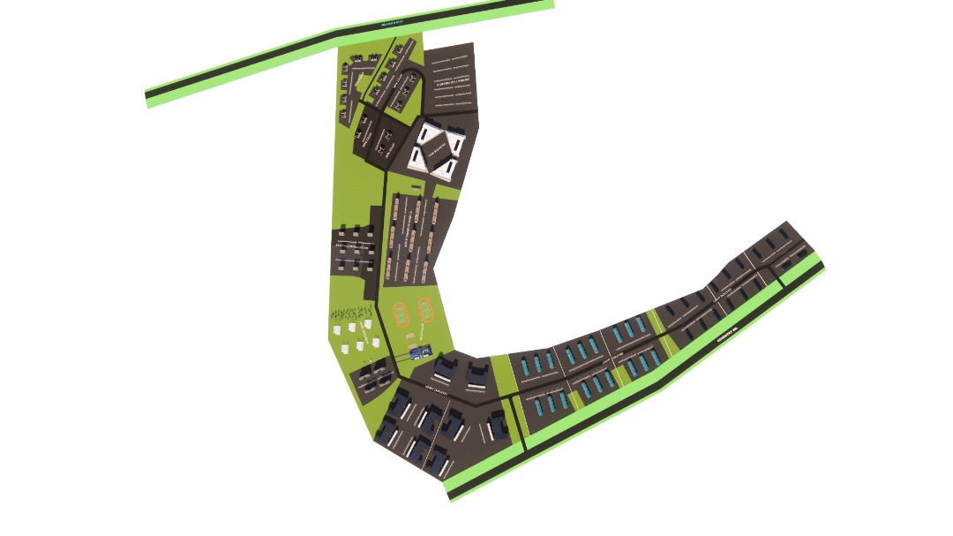
High Tech Development Valley
194 Hectares of Land
Samora Machel Road
Conference Facilities
Commerce Park
Heavy Industry
Staff Houses
Students
Light Industry
Cyber Park
Sports
Coventry Road

Slide 12
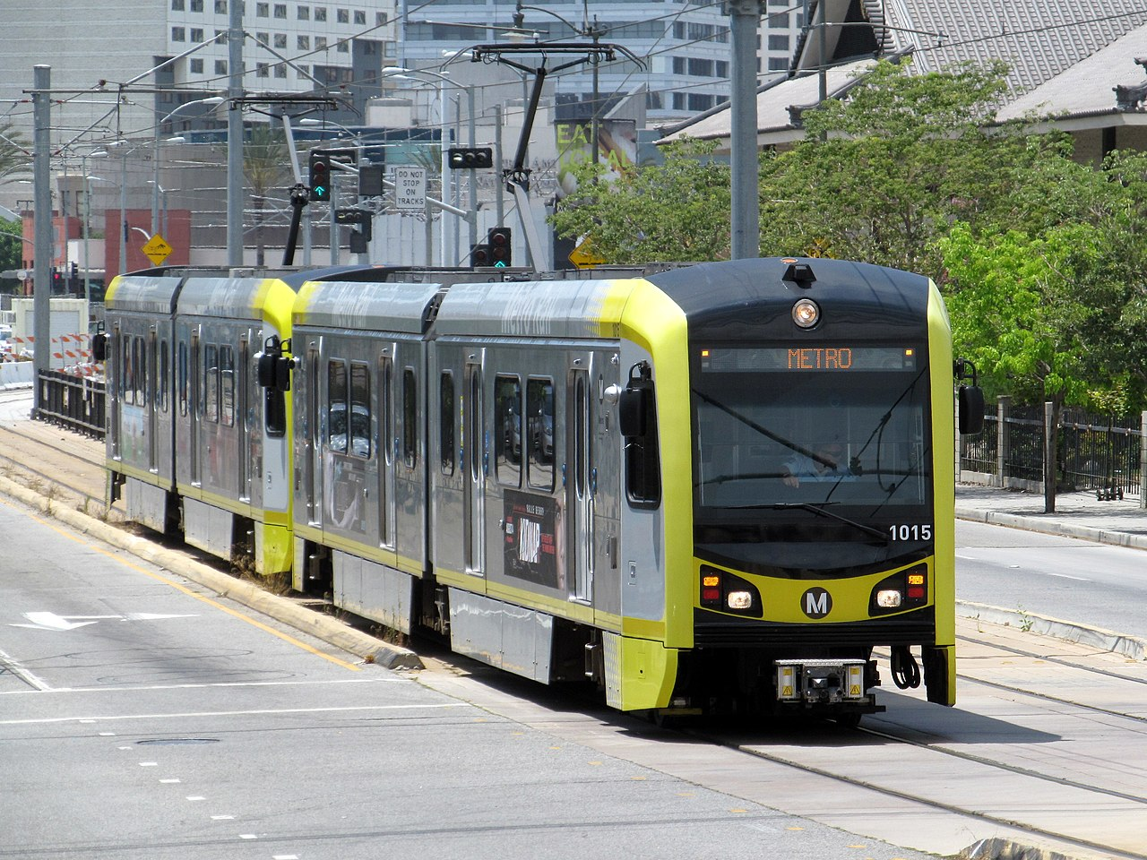
VISION FOR LRV TRAM FOR MASS URBAN TRANSPORTATION IN ZIMBABWE
To revolutionize urban mobility in Zimbabwe by creating a sustainable, efficient, and accessible mass transport system that meets the needs of a growing population, enhances connectivity, and fosters environmental stewardship, ultimately transforming our cities into vibrant, livable communities.

Slide 13
LIGHT RAIL VEHICLE (LRV) TRAM FOR MASS URBAN TRANSPORTATION IN ZIMBABWE
Objectives
Establish a national centre for urban mass transportation equipped with design, manufacture and testing facilities for light rail vehicles.
Develop and manufacture and deploy light rail vehicles on networks established in Zimbabwe
Develop, manufacture rail ticketing, communications and security infrastructure.

Slide 14
LIGHT RAIL VEHICLE (LRV) TRAM FOR MASS URBAN TRANSPORTATION IN ZIMBABWE
Expected Impact
Improved traffic management and mobility of citizens
Improved security and management of public spaces
Development of a multi-billion-dollar tram manufacturing industry in Africa
At least 10 000 jobs created directly and in downstream industries
Contribution to the value of the steel industry
Sustainable Development: As a clean energy solution, battery-powered systems support Harare's environmental goals, encouraging urban development that prioritizes sustainability and reduces carbon footprints.

Slide 15
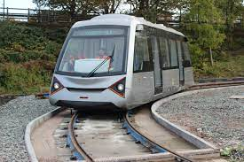
Case Studies & Global Best Practices
Coventry Very Light Rail (UK): University–city partnership delivering low-cost, modular tram systems.
Addis Ababa Light Rail (Ethiopia): Integrated urban rail system improving mobility and reducing emissions.
Bogotá TransMilenio (Colombia): Bus Rapid Transit (BRT) system as a scalable, cost-effective solution.
Key Takeaway: Localized innovation, public-private partnerships, and strong policy frameworks are critical.

Slide 16
Policy Recommendations
Integrated Urban Mobility Planning: Develop a multimodal transport master plan.
Smart Mobility Solutions: Invest in intelligent transport systems (ITS), e-ticketing, and real-time traffic management.
Formalization of Public Transport: Transition informal operators into regulated cooperatives.
Incentivize Clean Transport: Promote electric vehicles and non-motorized transport infrastructure.
Institutional Coordination: Strengthen collaboration between city councils, ministries, Industry and academia.

Slide 17
Call to Action
Government: Enable policy reforms and provide catalytic funding.
Private Sector: Invest in transport infrastructure and innovation.
Academia (HIT): Lead R&D, skills development, and commercialization.
Communities: Embrace sustainable transport culture and behaviour change.
Development Partners: Support pilot projects and capacity building.

Slide 18
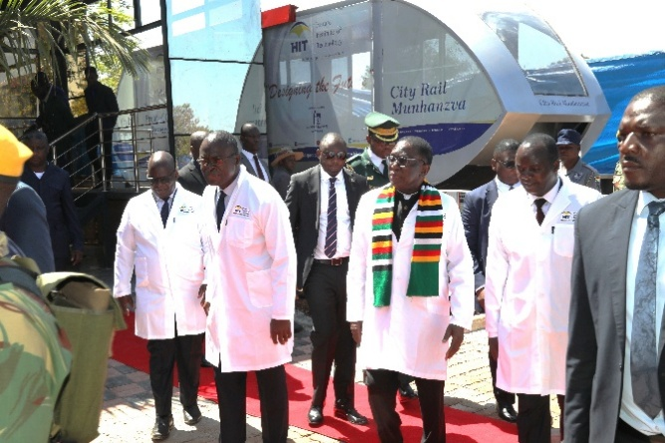
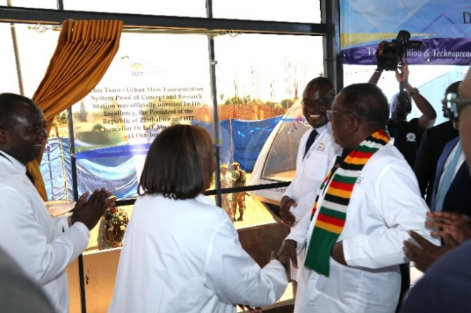
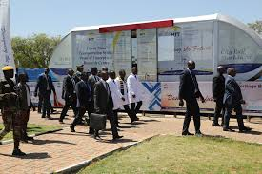
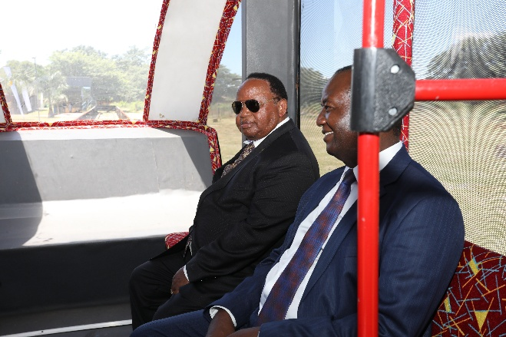
Conclusion
HIT is committed to shaping the future of urban mobility in Zimbabwe.
Through innovation, collaboration, and strategic foresight, we aim to deliver transport solutions that are inclusive, sustainable, and transformative.
Let’s move Harare forward—together.

Slide 19

START-UP & SPIN-OFF COMPANIES

